Slide 1
无人机识别挑战卡

Slide 2
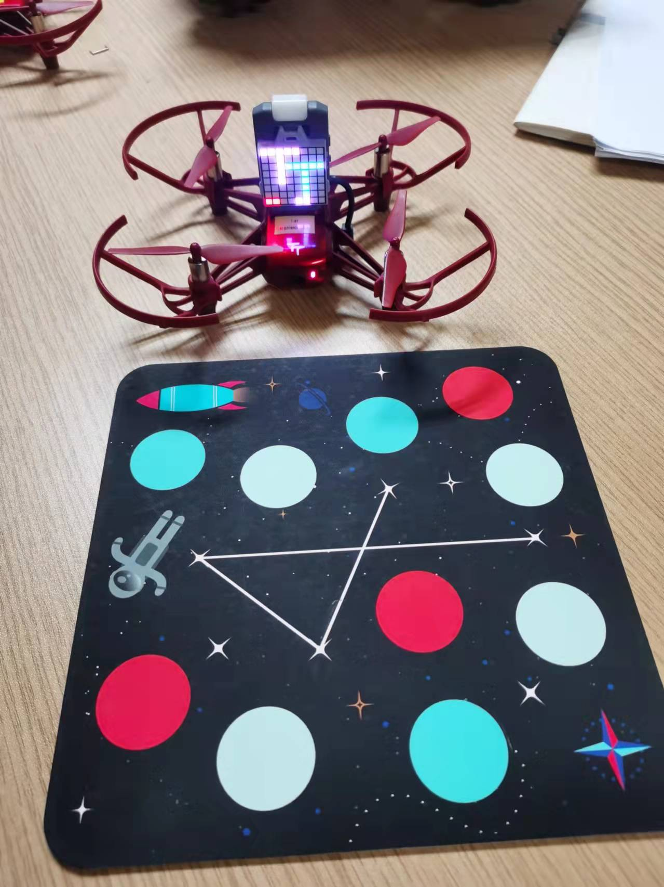
一、任务
无人机识别挑战卡的编号，获取相当于挑战卡的坐标位置，完成相对定位。

Slide 3
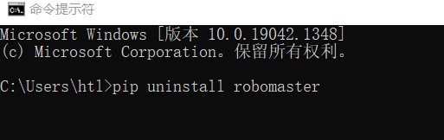
二、要做的几件事情
1、更新SDK
（1）卸载旧的SDK:在命令提示行，pip uninstall robomaster

Slide 4
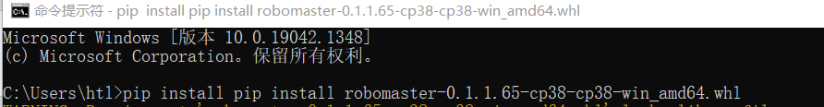
二、要做的几件事情
1、更新SDK
（2）安装新的SDK:
在命令提示行，
pip install robomaster-0.1.1.65-cp38-cp38-win_amd64.whl

Slide 5
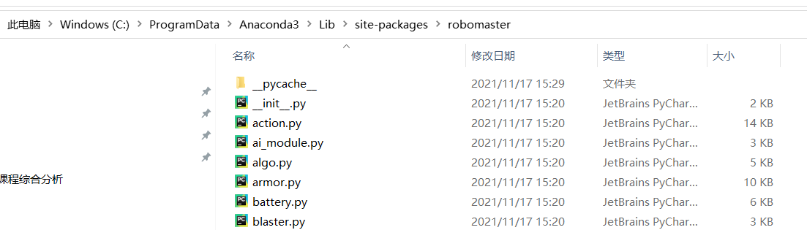
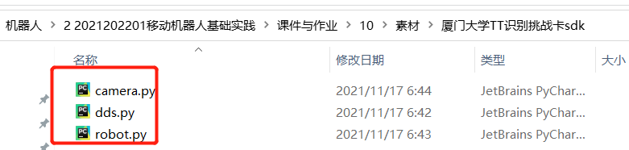
二、要做的几件事情
1、更新SDK
（3）在安装文件下，替换覆盖以下三个文件
C:\ProgramData\Anaconda3\Lib\site-packages\robomaster

Slide 6
三、挑战卡程序：17_sub_info.py
import robomaster from robomaster import robot import time def sub_mission_pad_info_handler(mission_pad_info): MID, x, y, z = mission_pad_info print("Drone Mission Pad: MID {0}, x {1}, y {2}, z {3}".format(MID, x, y, z)) if __name__ == '__main__': tl_drone = robot.Drone() time.sleep(1) tl_drone.initialize() print('1') # 订阅飞行器信息 tl_drone._sub_drone_all_status(freq=10, callback=sub_mission_pad_info_handler) print('2') time.sleep(1) print('3') time.sleep(10) # 取消订阅信息 tl_drone._unsub_drone_all_status() print('5') tl_drone.close()
功能：
返回挑战卡的编号、坐标

Slide 7
四、下视视频：25_get_downvision.py
功能：
通过下视，实时返回图像
import cv2 from robomaster import robot if __name__ == '__main__': tl_drone = robot.Drone() tl_drone.initialize() tl_camera = tl_drone.camera # 显示302帧图传 tl_camera.set_down_vision(setting=1) tl_camera.start_video_stream(display=False) for i in range(0, 302): img = tl_camera.read_cv2_image() cv2.imshow("Drone", img) cv2.waitKey(1) cv2.destroyAllWindows() tl_camera.stop_video_stream() tl_drone.close()

Slide 8
五、飞行与下视定位：flight_sub_ino.py
功能：边飞边返回视频边返回坐标
import cv2 from robomaster import robot import time def sub_mission_pad_info_handler(mission_pad_info): MID, x, y, z = mission_pad_info print("Drone Mission Pad: MID {0}, x {1}, y {2}, z {3}".format(MID, x, y, z)) img = tl_camera.read_cv2_image() cv2.imshow("Drone", img) cv2.waitKey(1) if __name__ == '__main__': tl_drone = robot.Drone() tl_drone.initialize() #打开下视摄像头 tl_camera = tl_drone.camera tl_camera.set_down_vision(setting=1) tl_camera.start_video_stream(display=False)

Slide 9
# 订阅标签信息 tl_drone._sub_drone_all_status(freq=10, callback=sub_mission_pad_info_handler) tl_flight = tl_drone.flight time.sleep(1) print('2') tl_flight.takeoff().wait_for_completed() tl_flight.forward(distance=100).wait_for_completed() tl_flight.backward(distance=100).wait_for_completed() print('2') tl_flight.land().wait_for_completed() print('3') # 取消订阅信息 tl_drone._unsub_drone_all_status() cv2.destroyAllWindows() tl_camera.stop_video_stream() tl_drone.close()

